Slide 1
A discrete SAR ADC/DAC
Philipp Schilk HS2020
P&S “iCEBreaker FPGA For IoT Sensing Systems”
Center for Project Based Learning / ETH Zuerich

Slide 2
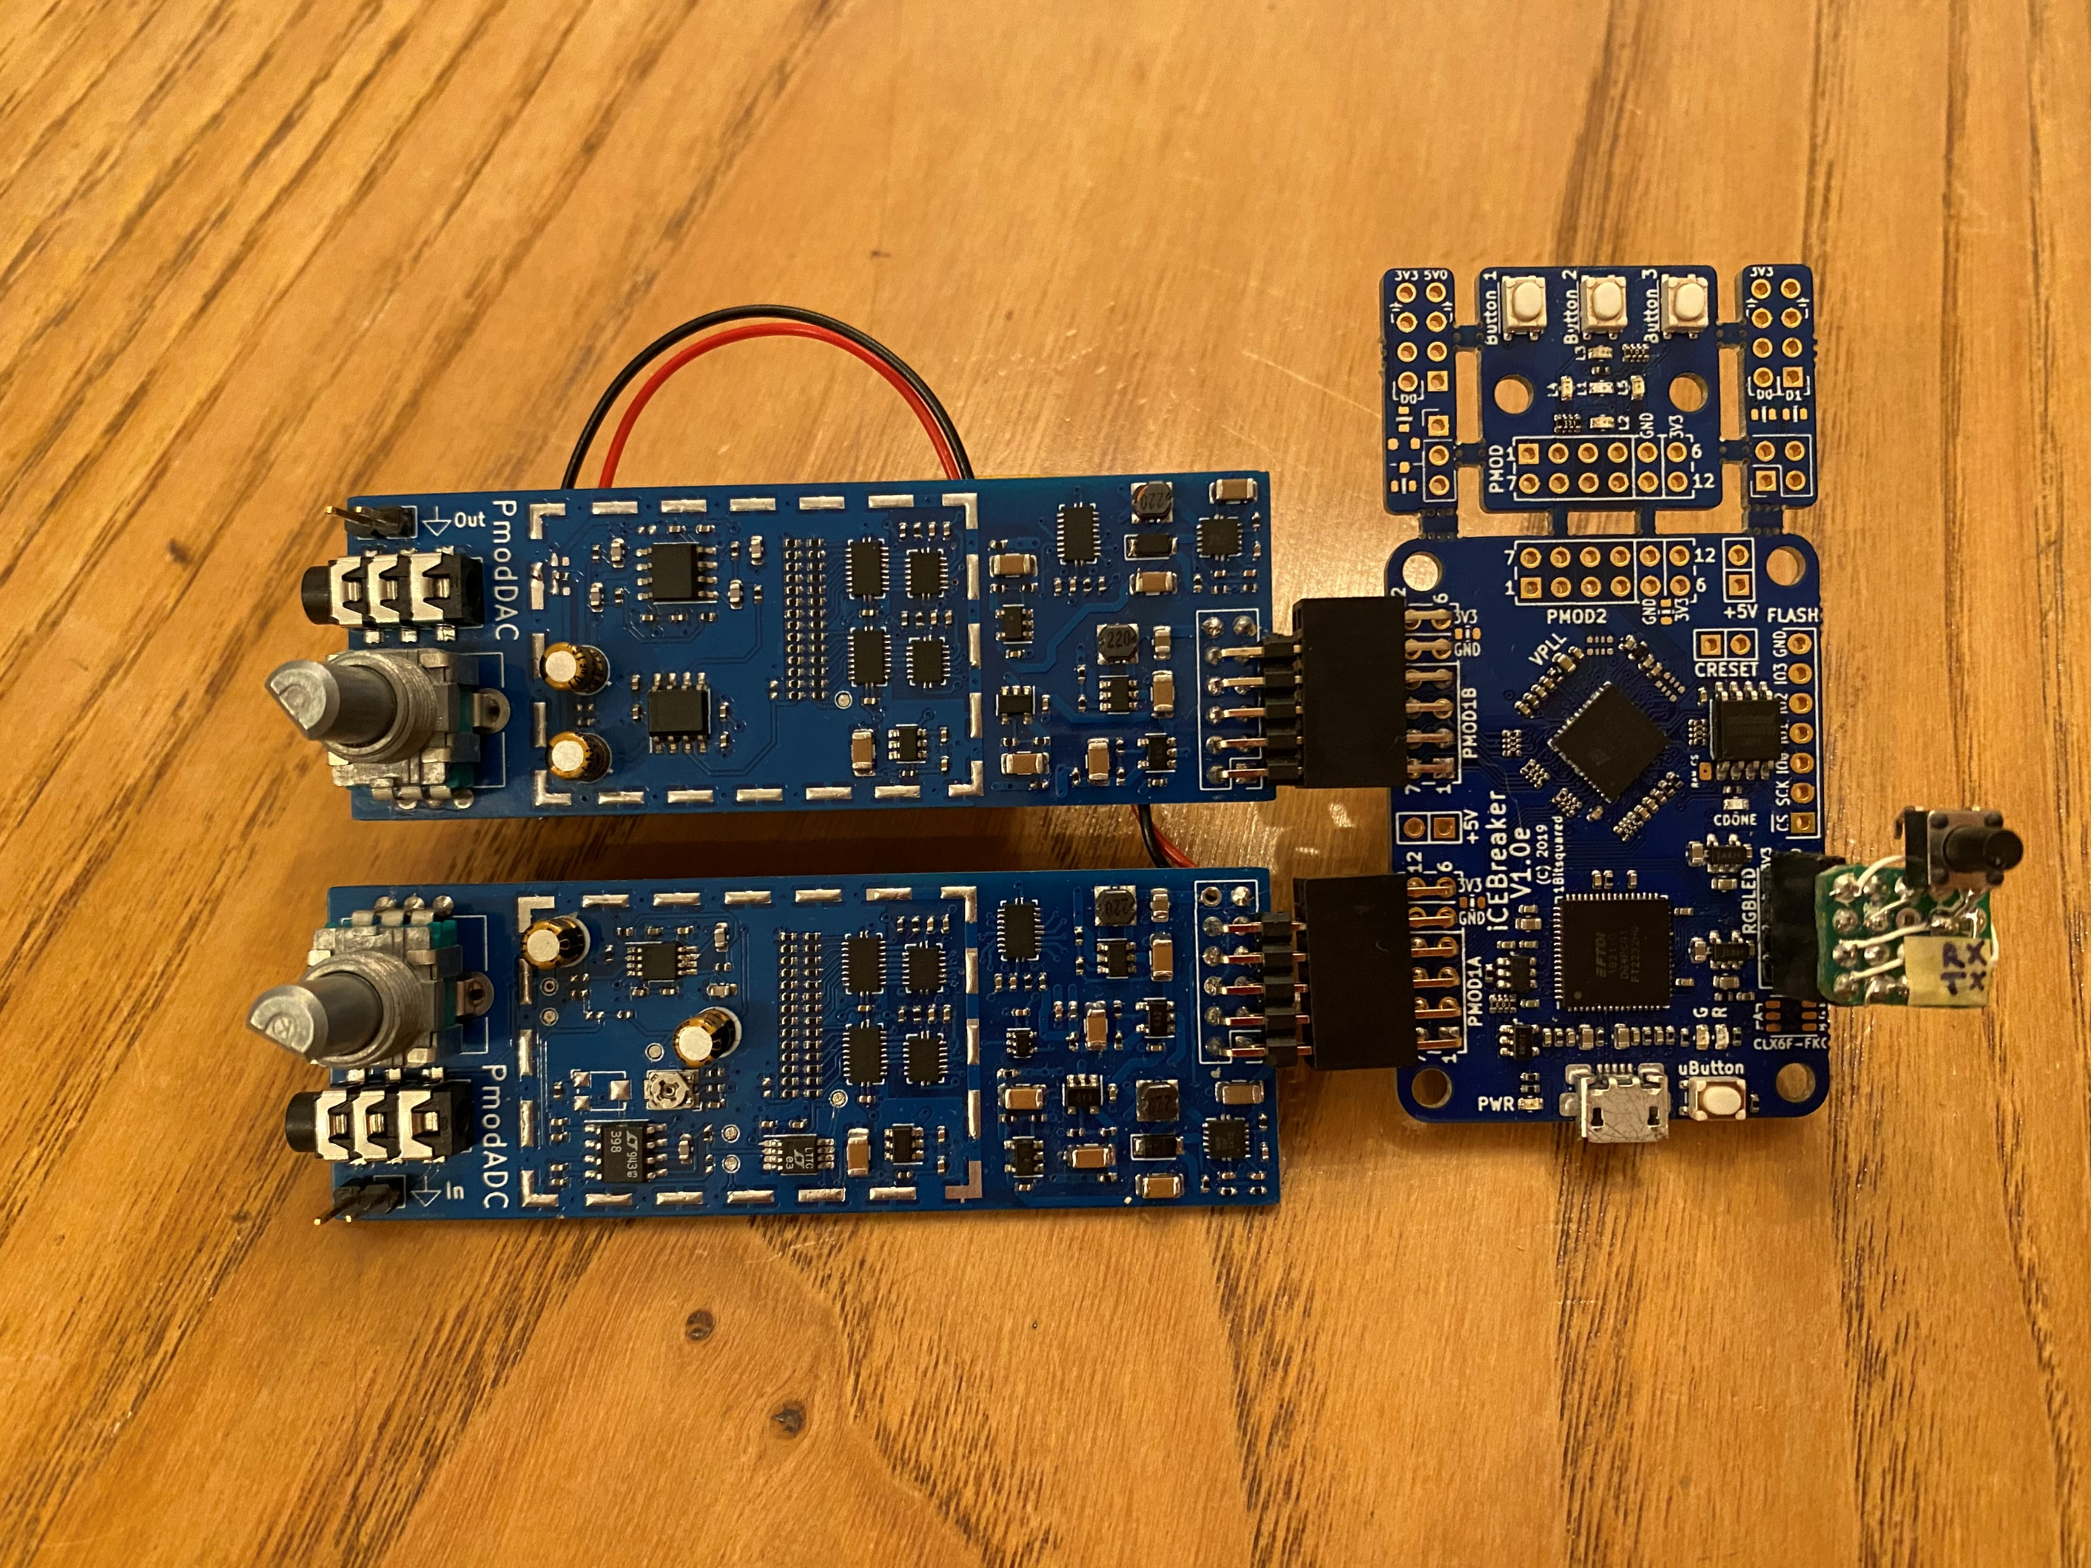
Overview
ADC and DAC
14bit Resolution
41kHz Sample Rate
Custom Circuit and Hardware
Realtime Bidirectional USB Communication
Python Scripts for Recording and Playback
MATLAB Scripts for Recording, Playback, and Characterization

Slide 3
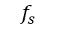
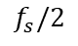
Operating Principle
Vin
Vs/h
Amplifier
Filter
S&H
Input
Comparator
$$f_{s}/2$$
$$f_{s}$$
Vsh
+
-
Vmax
Vdac
SAR-Logic
FPGA
DAC
Vmax/2
Digital Out
Vdac
Vs/h
1
0
1
0
0
0
1
1
0
1
Comparator

Slide 4
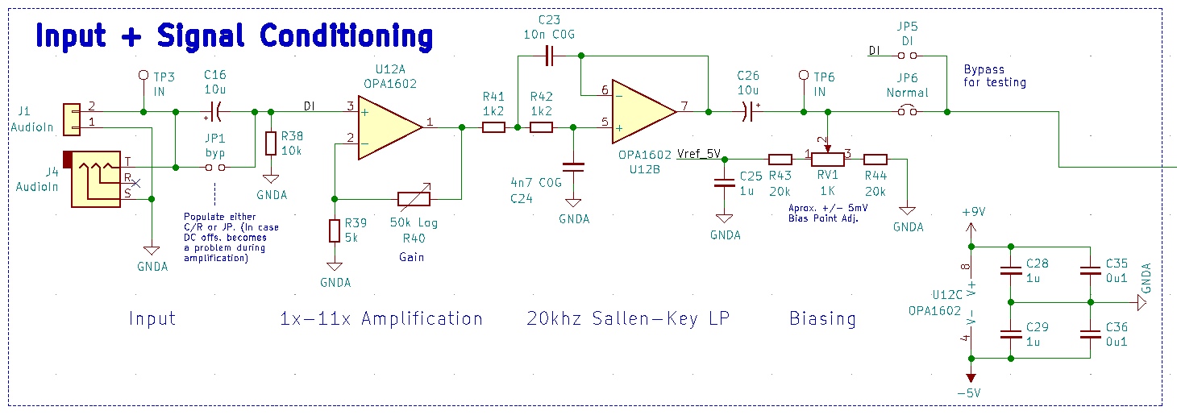
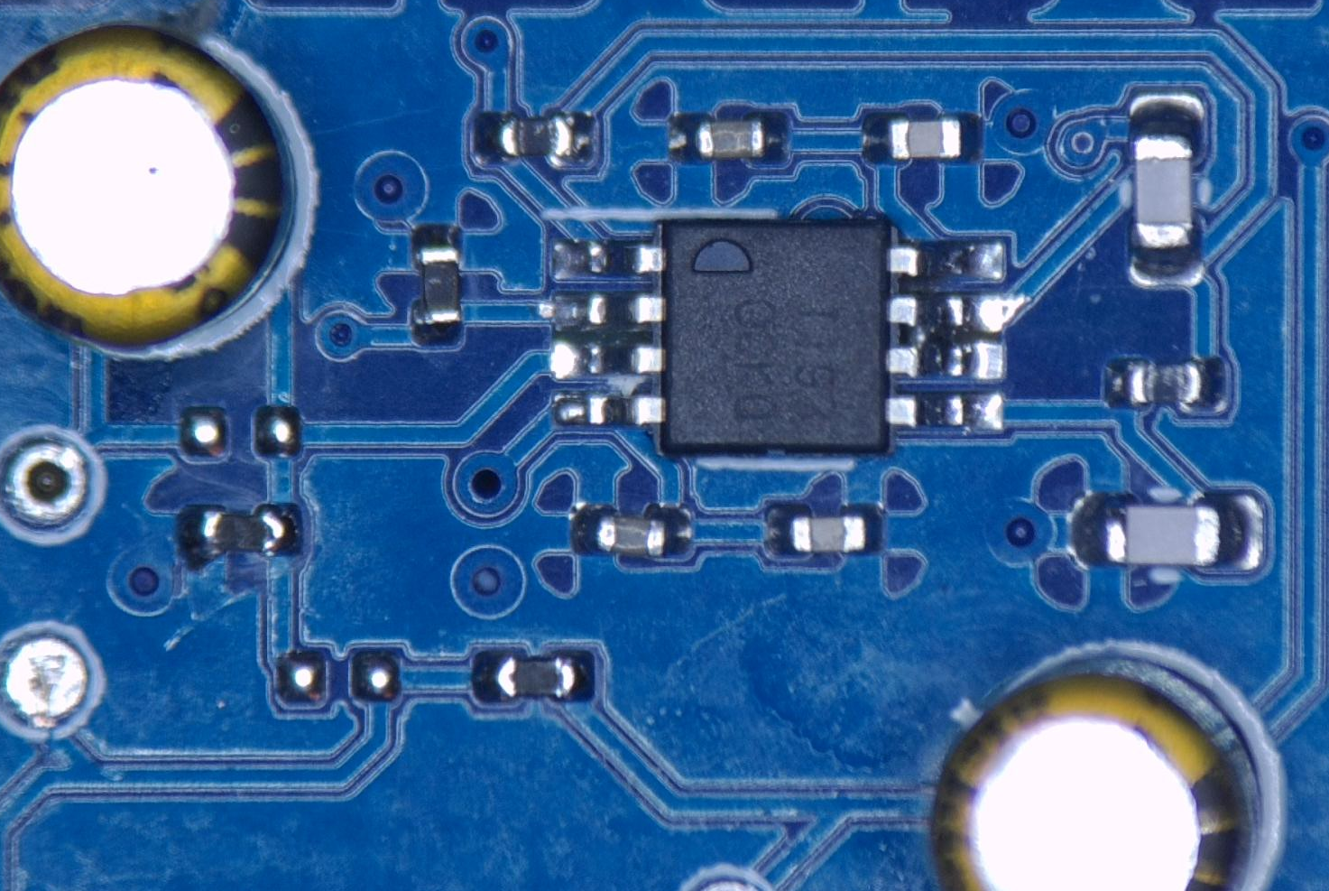
Hardware Implementation

Slide 5
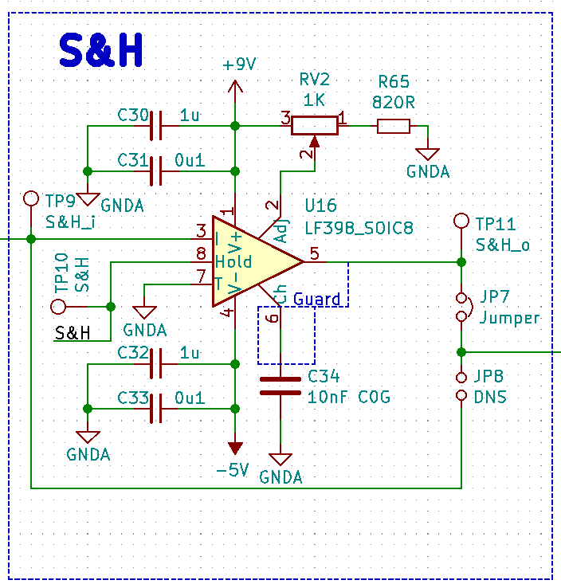
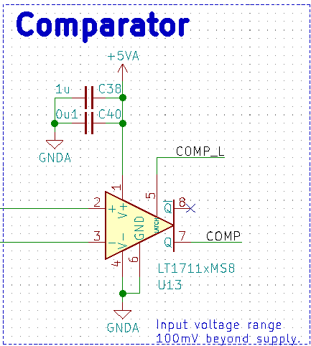
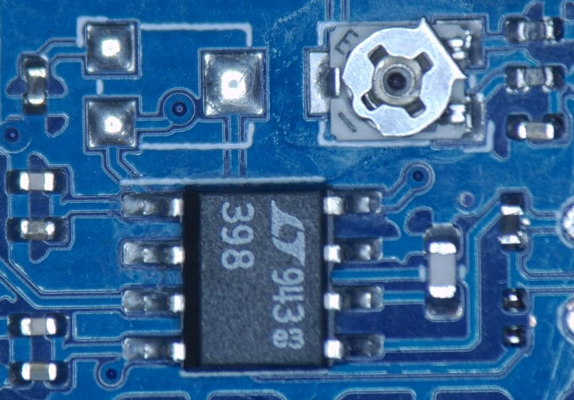
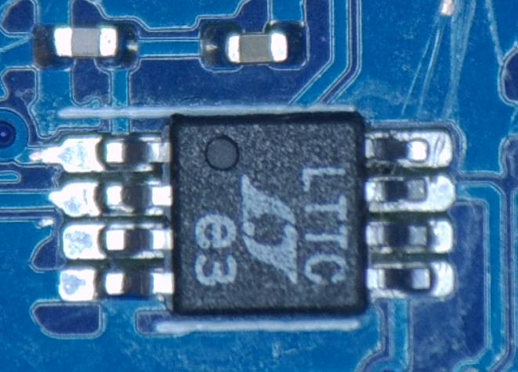
Hardware Implementation

Slide 6
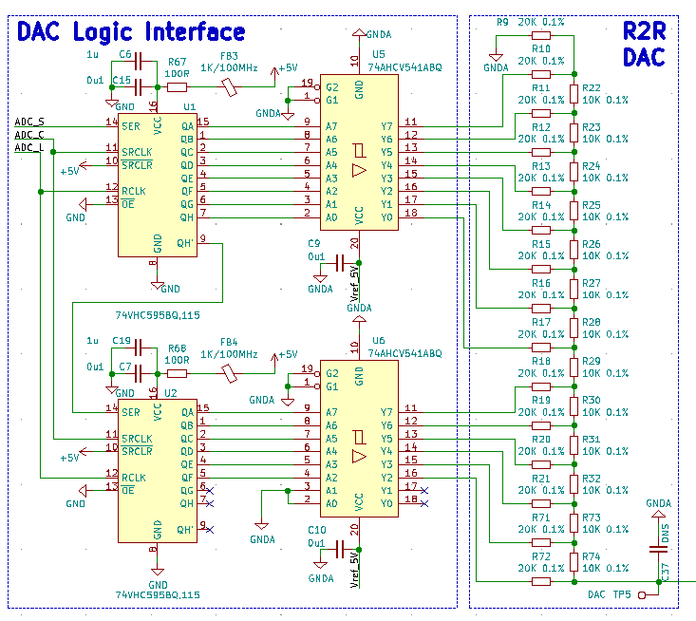
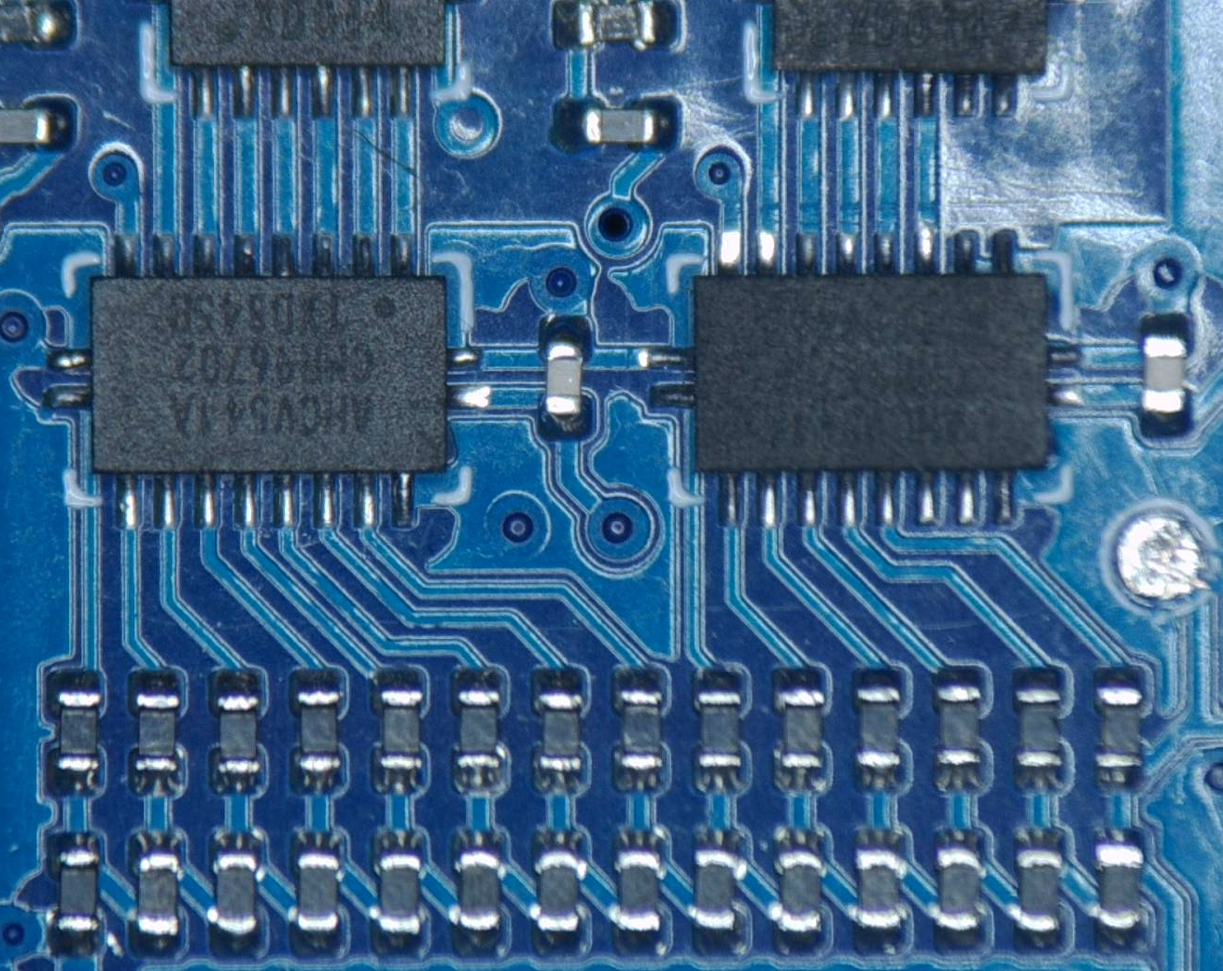
Hardware Implementation

Slide 7
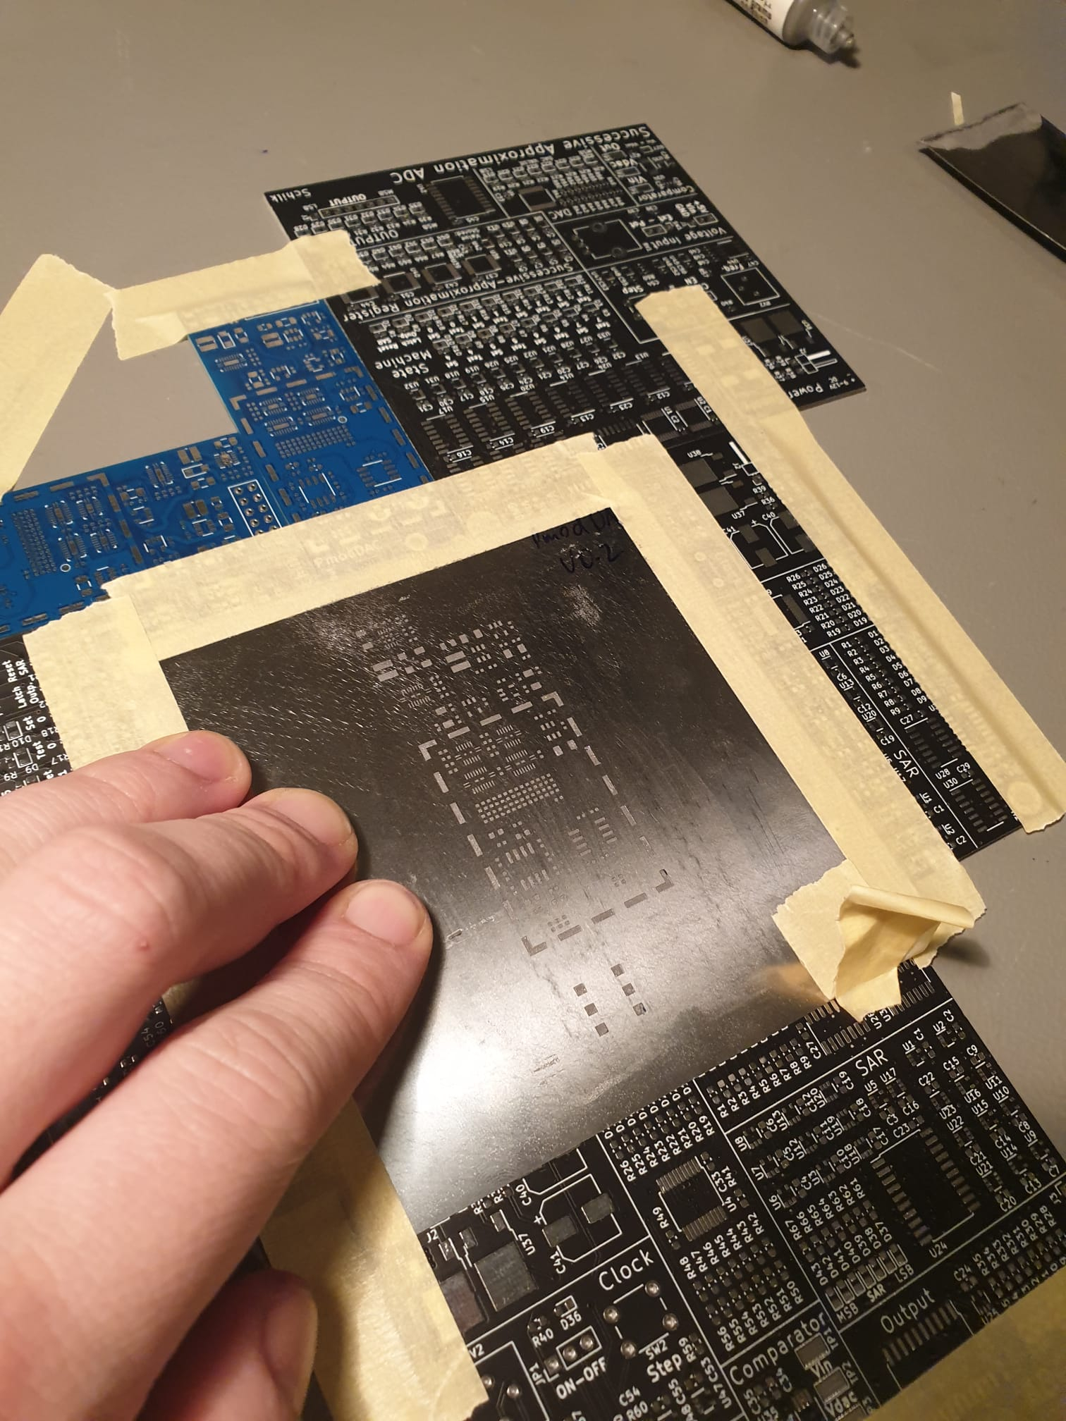
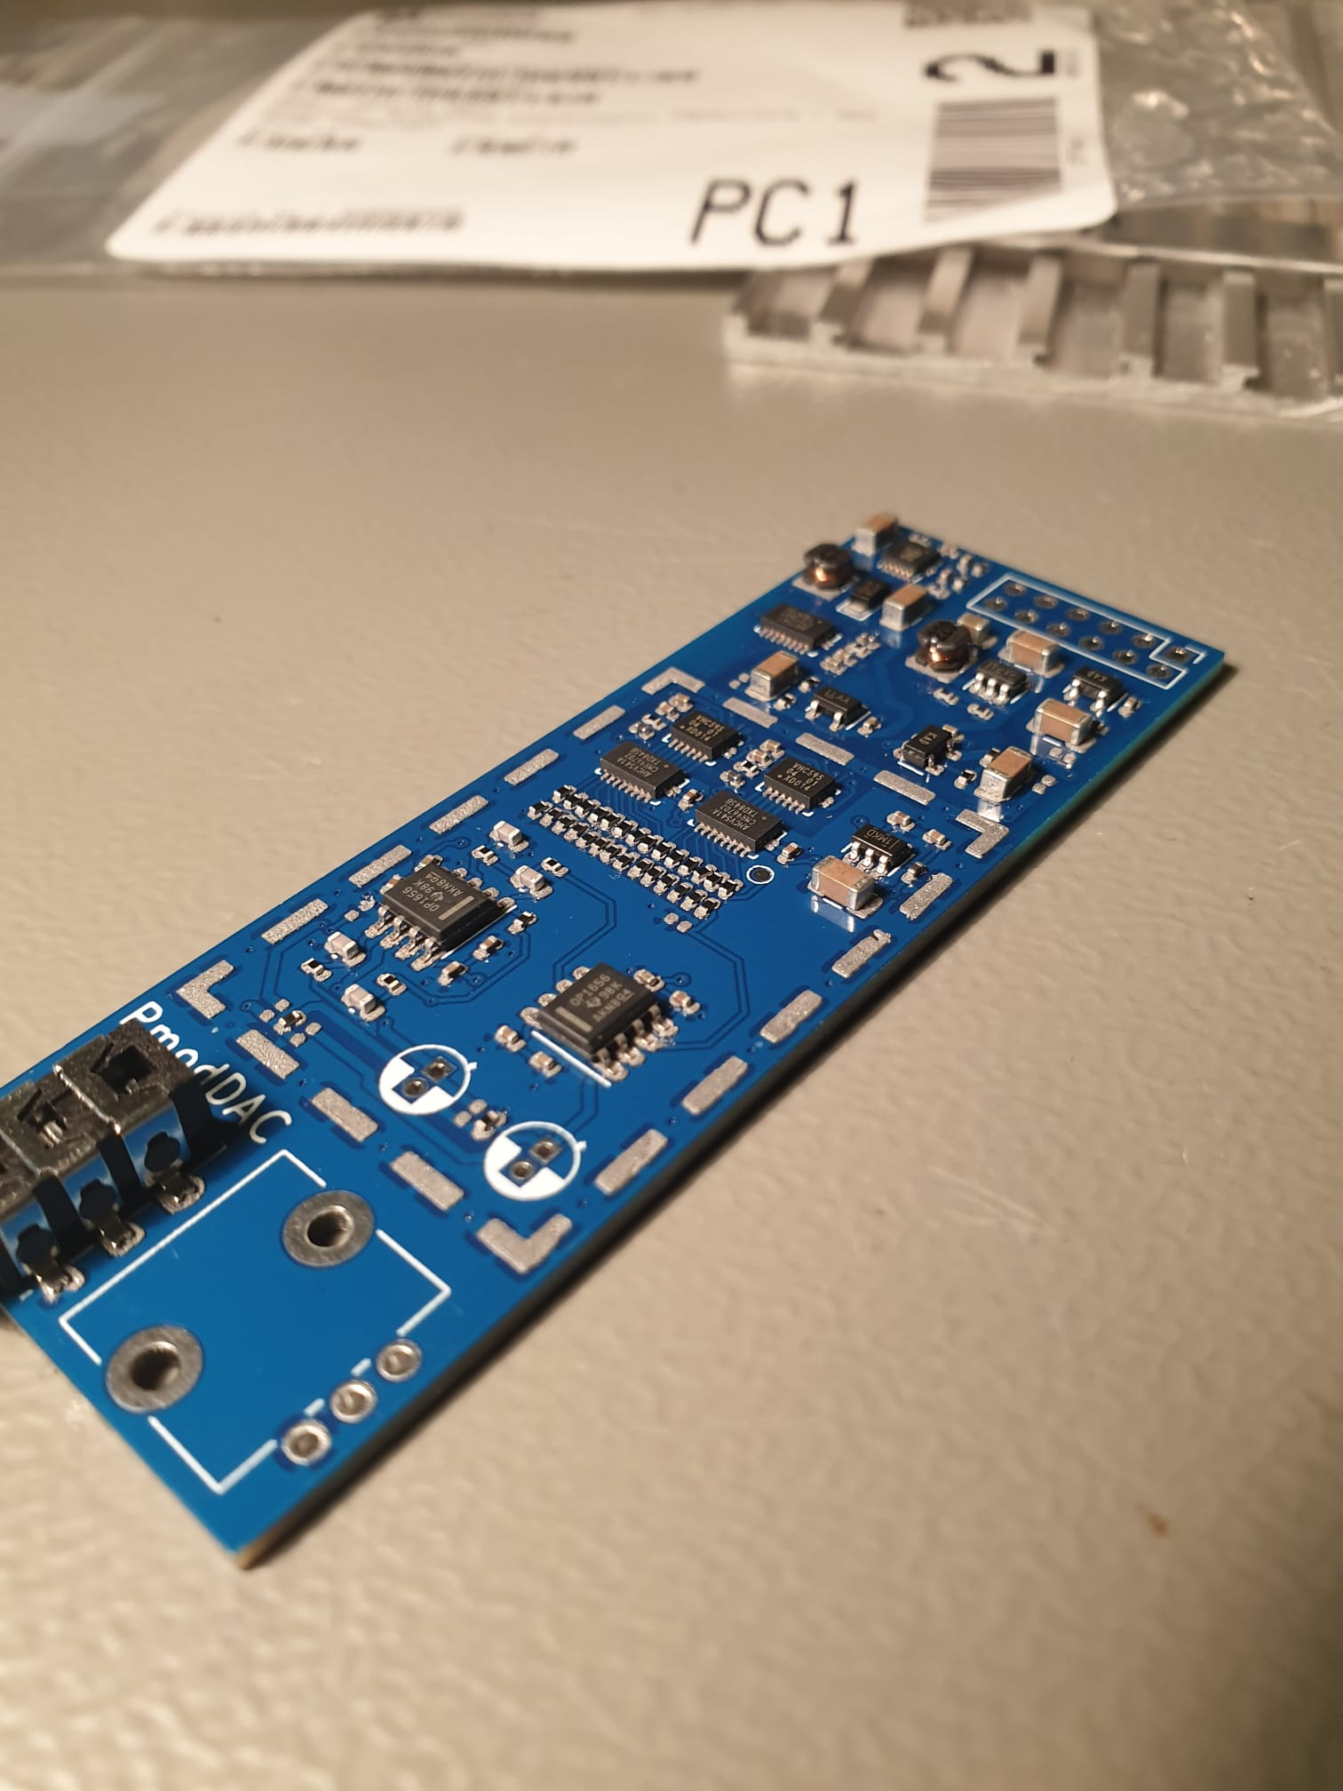
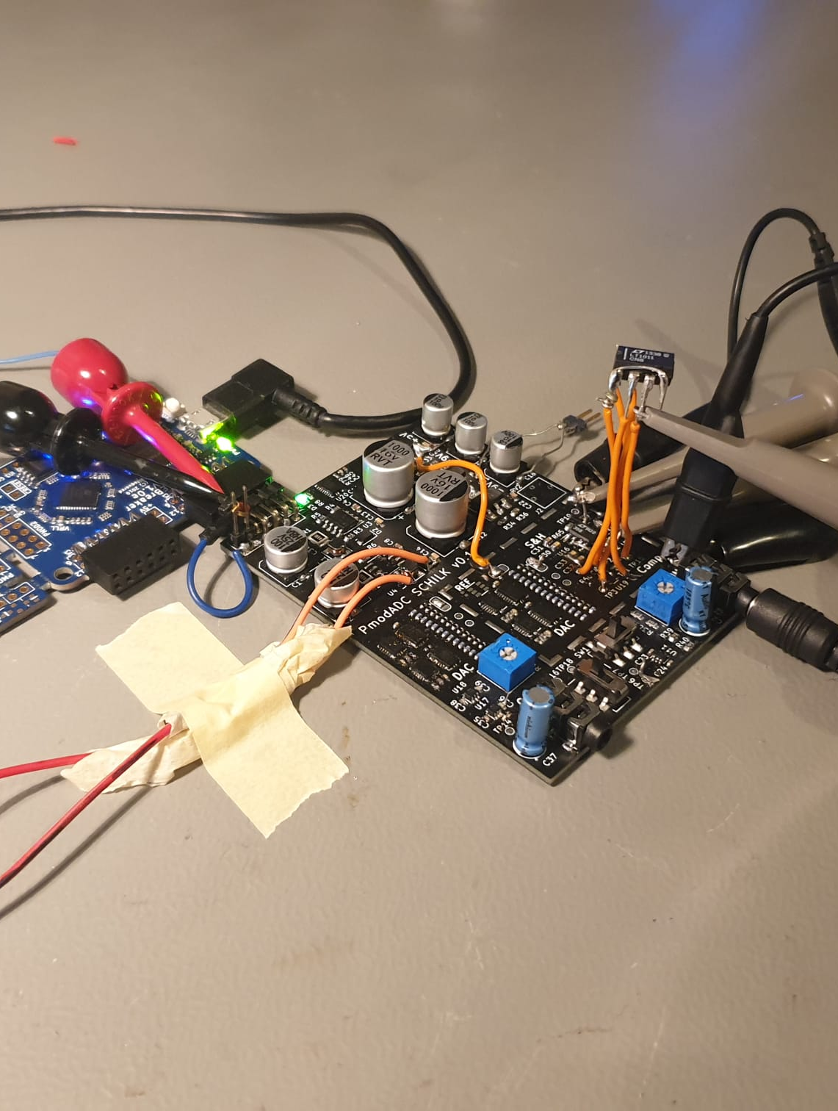
Construction

Slide 8
Verilog Implementation
iCEBreaker FPGA
FT2232H FIFO
Computer
Interface
ADC Interface
PmodADC
DAC Interface
DAC Interface
PmodDAC

Slide 9
Verilog Implementation: DAC Interface
Shiftout: Latch
Data Ready
No Data Ready
Not Done
IDLE
Shiftout: Shift
Done
Latchout

Slide 10
Verilog Implementation: ADC Interface
Waiting
S&H: Settle
Sampling finished
Settling finished
Conversion not
done
Waiting
S&H: Sample
DAC SET
Conversion
done

Slide 11
Verilog Implementation: Computer Interface
TX 1
Waiting
Data Ready
TX1 OK
IDLE
TX 2
TX1 Failed
RX1 Failed
RX2
RX1
RX1 OK

Slide 12
Operation

Slide 13
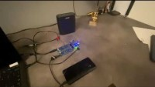
Demonstration

Slide 14
Demonstration
Song | Original | PmodADC Demo | PmodDAC Demo
New Hero in Town | here | here | here
Protofunk | here | here | here
Whiskey on the Mississippi | here | here | here
The Parting | here | here | here
https://github.com/TheSchilk/PmodADC
https://soundcloud.com/user-489490213/sets/pmodadc-demonstration/s-fJryQAe7XSp

Slide 15
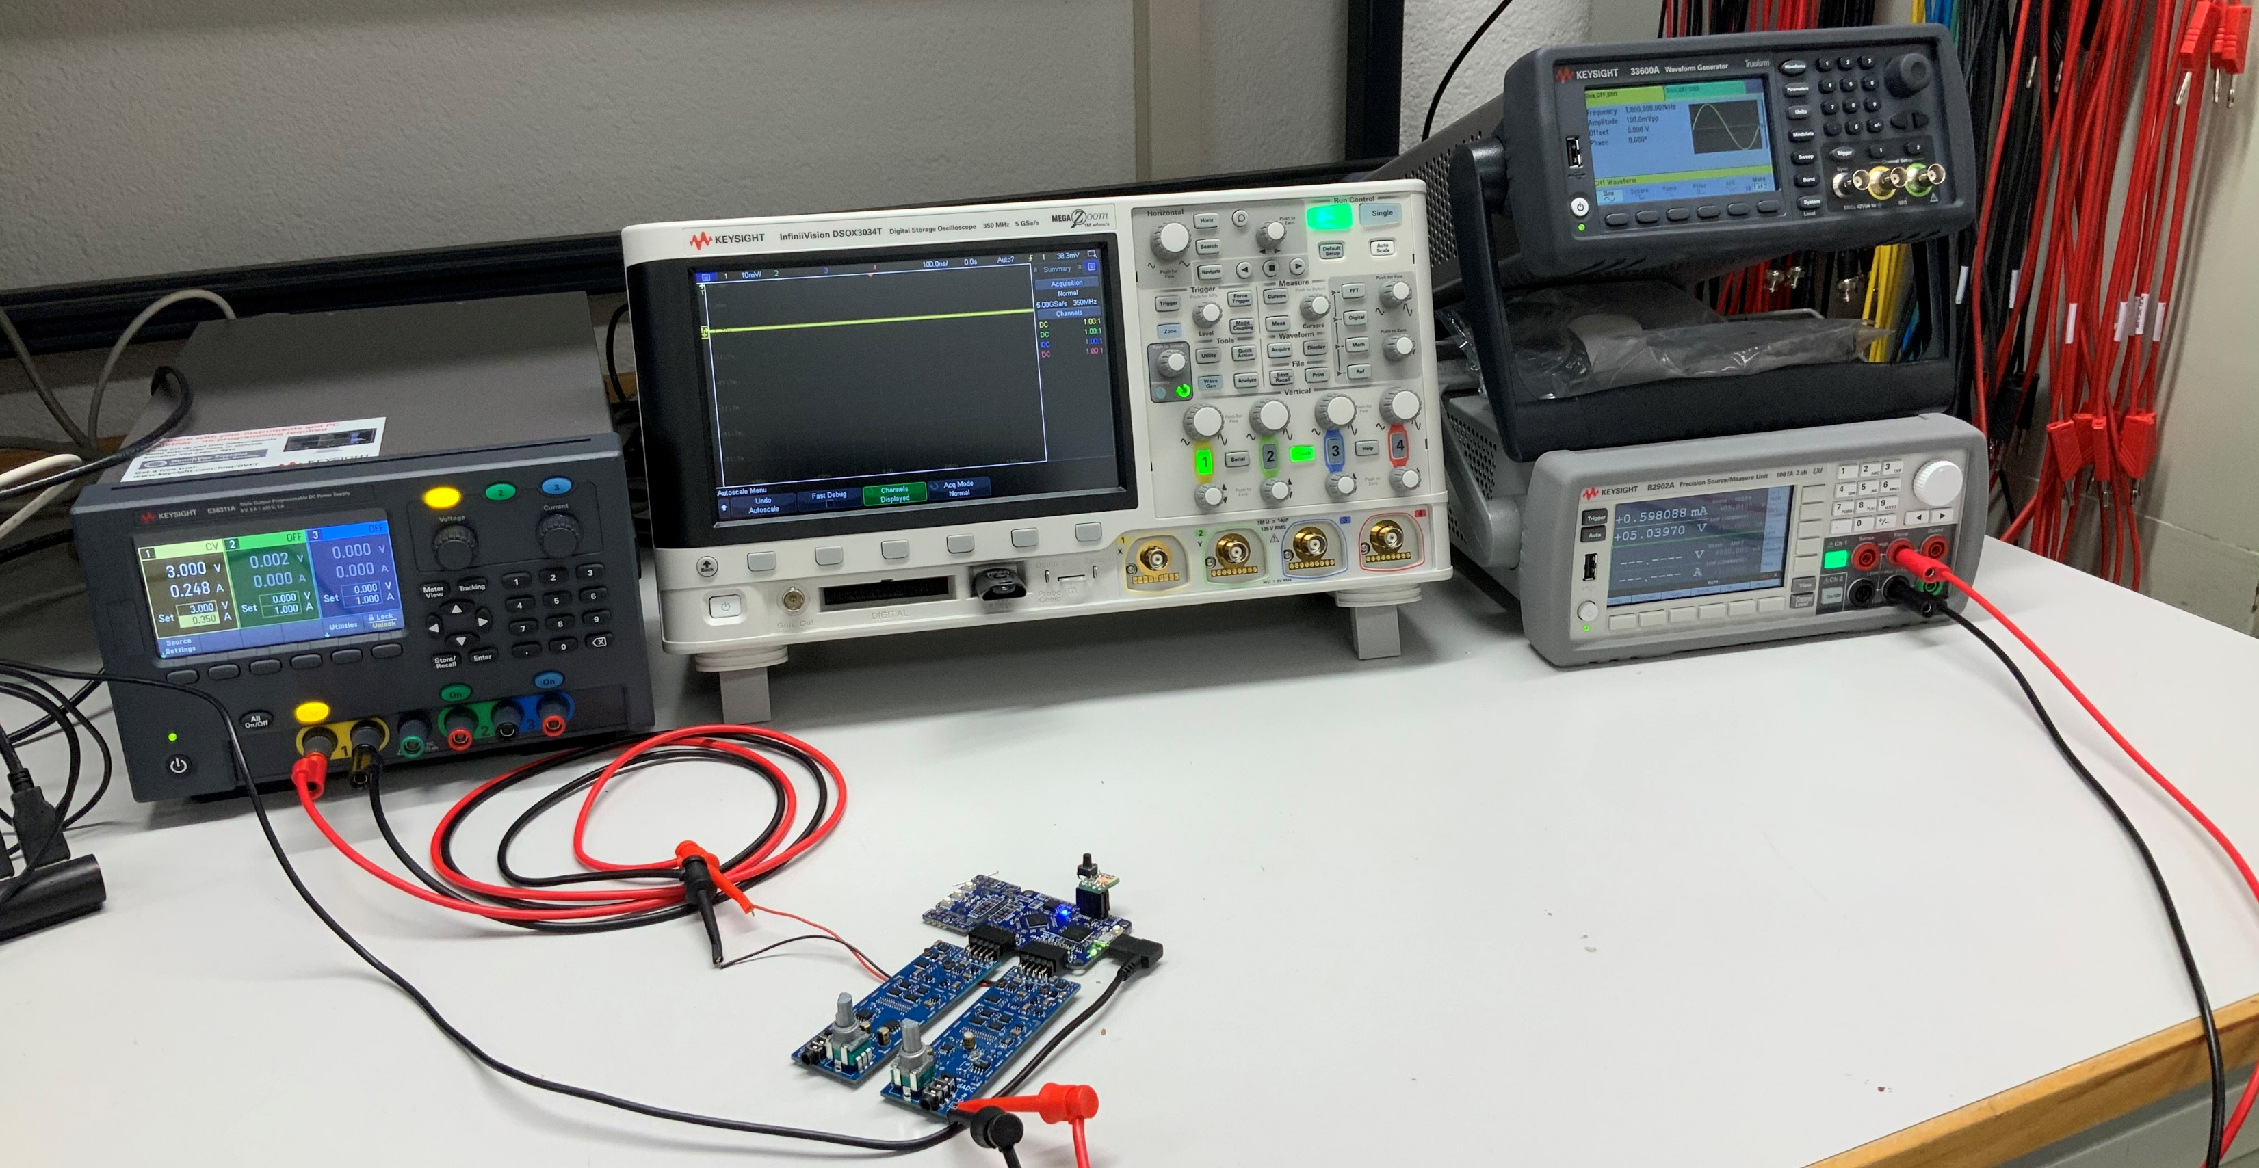
Characterization

Slide 16
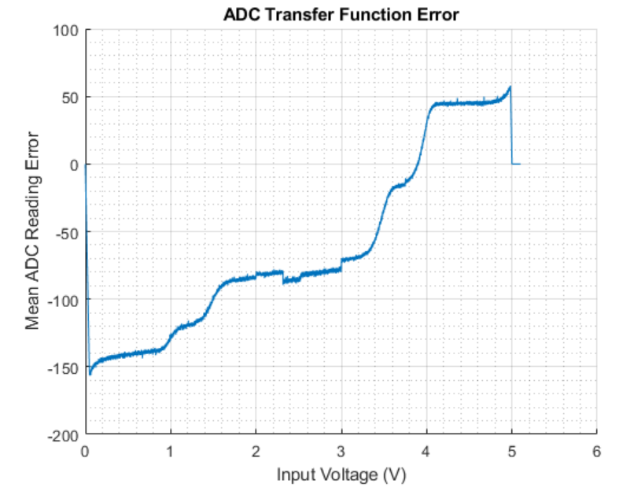
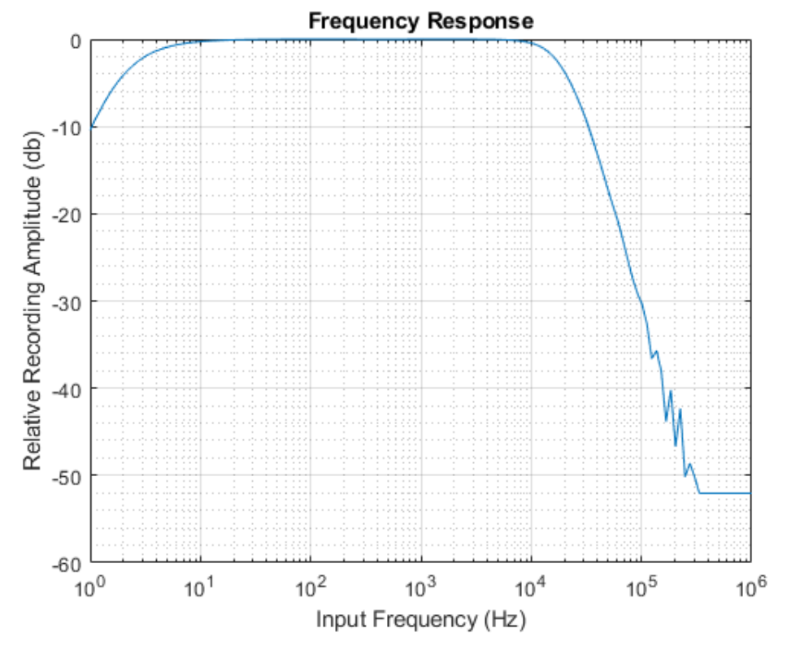
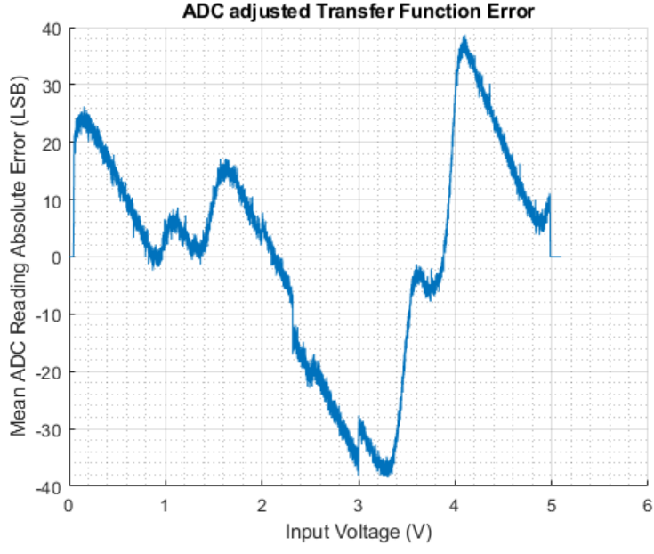
Characterization Results

Slide 17
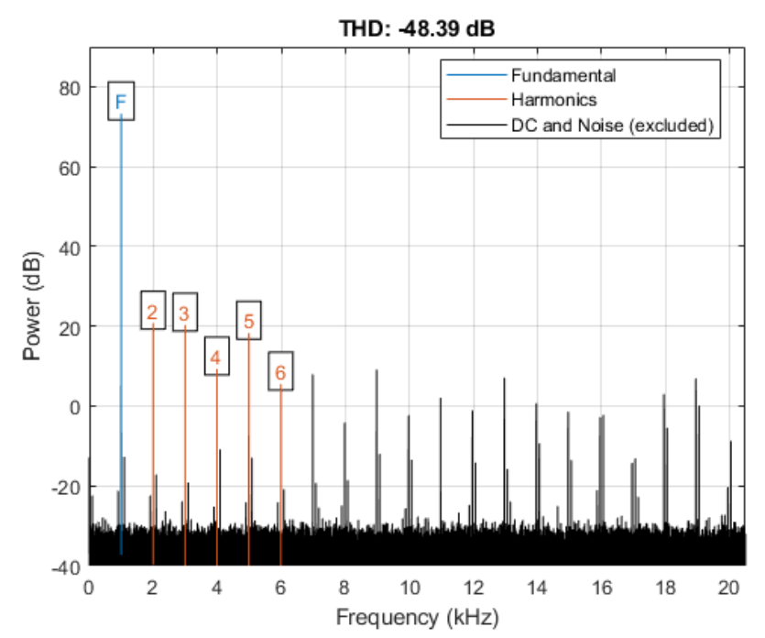
Characterization Results

Slide 18
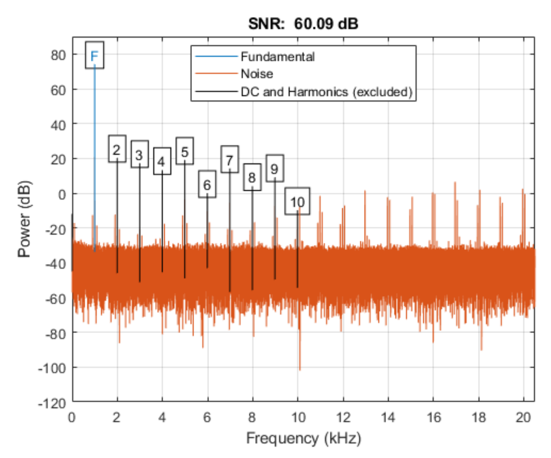
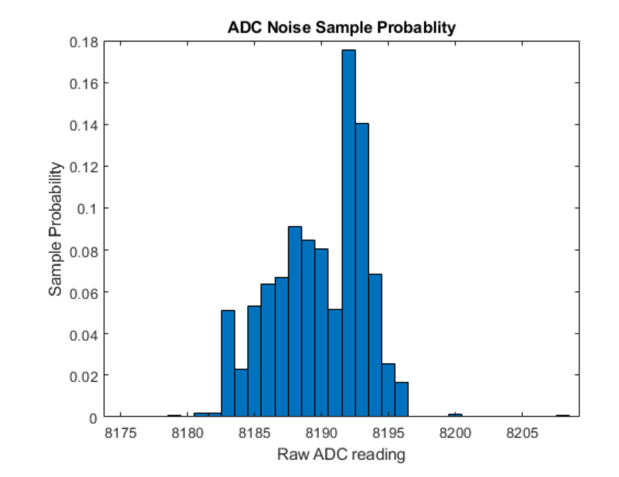
Characterization Results

Slide 19
Comparison Recordings:
https://soundcloud.com/user-489490213/sets/pmodadc-demonstration/s-fJryQAe7XSp
All Design Files, Code, Scripts, Characterization Reports, Documentation, … :
https://github.com/TheSchilk/PmodADC
In Particular:
KiCAD Projects
Schematics/Gerbers (https://github.com/TheSchilk/PmodADC/tree/master/ProductionFiles)
Verilog
Characterization Results (https://github.com/TheSchilk/PmodADC/tree/master/Characterization )
Interface Scripts

Slide 20

Thank you!
Questions?

